Slide 1
CARD FLIP (A Memory Game)
Created by
Omkar & Vishal

Slide 2
Card flip
Introduction
How to play
Benefit of playing
Tips for improving
Conclusion

Slide 3
INTRO
Card Flip Online Memory Game is a fun and challenging game that tests your memory skills. The game involves flipping cards and matching pairs of identical cards. It is a great way to improve your concentration, memory, and cognitive skills.
The game is available online and can be played on any device with an internet connection. It is easy to play and suitable for all ages. Whether you are looking for a quick brain workout or a fun way to pass the time, Card Flip Online Memory Game is the perfect choice.

Slide 4
How to Play
To play Card Flip Online Memory Game, simply click on a card to flip it over and reveal the image on the other side. Then, click on another card to flip it over and reveal its image. If the two cards match, they will stay flipped over. If they don't match, they will flip back over and you will have to try again.
The goal of the game is to match all the pairs of identical cards as quickly as possible. The faster you complete the game, the higher your score will be. You can also challenge yourself by trying to beat your previous best time.

Slide 5
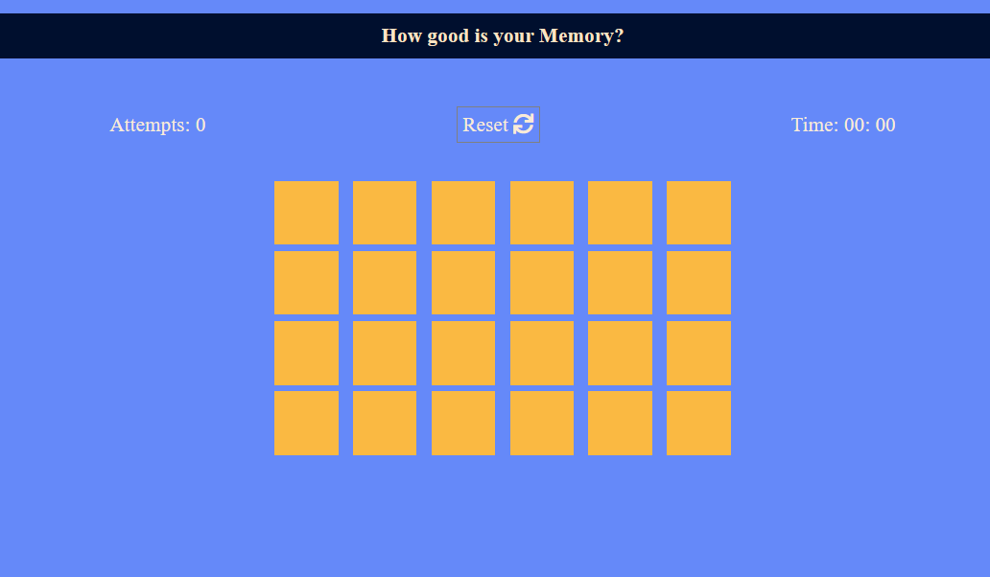
Starting page of our game

Slide 6

Benefits of Playing Card Flip Game
Playing Card Flip Online Memory Game has several benefits for your brain and overall well-being. It helps to improve your memory and concentration skills by exercising your brain and challenging your ability to remember images and patterns.
It also helps to reduce stress and anxiety by providing a fun and engaging distraction from daily life. Additionally, it can improve your mood and boost your confidence as you see yourself improving and achieving better scores.

Slide 7
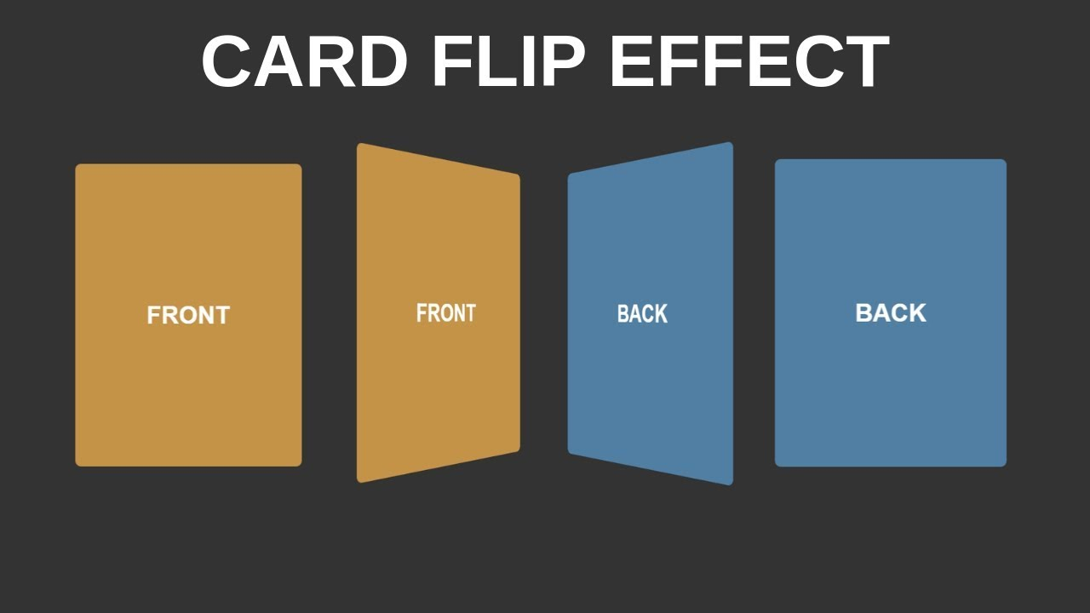
Features of Card Flip Game
Card Flip Online Memory Game has several features that make it a unique and enjoyable gaming experience. It has multiple levels of difficulty, allowing you to choose the one that suits your skill level. It also has a timer feature that adds an extra challenge and helps to track your progress.

Slide 8
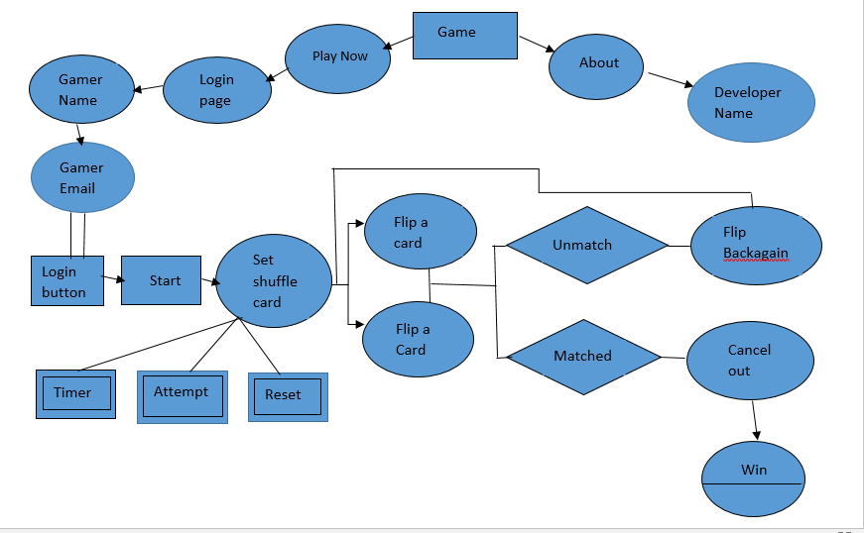
ER Diagram

Slide 9

Tips for Improving Your Skills
If you want to improve your Card Flip Online Memory Game skills, there are several tips and strategies you can use. First, try to focus on memorizing the location of the cards as you flip them over. This will help you to remember where the matching pairs are located.
You can also try to develop a system for flipping the cards, such as starting from one corner and working your way across the board. Finally, practice regularly to build your memory and concentration skills and improve your overall performance.

Slide 10
Conclusion
Card Flip Online Memory Game is a fun and challenging game that provides numerous benefits for your brain and overall well-being. With its multiple levels of difficulty, timer feature, and customizable card themes, it offers a unique and enjoyable gaming experience for all ages.
By practicing regularly and using the tips and strategies outlined before, you can improve your memory and concentration skills and achieve better scores.
So why not give it a try and see how much you can improve?

Slide 11
In this game, we will soon launched multiplayer mode and Online Platform for the players in all over region.
THANK YOU ☺

